Slide 1
Unit 4 lecture 9

Slide 2
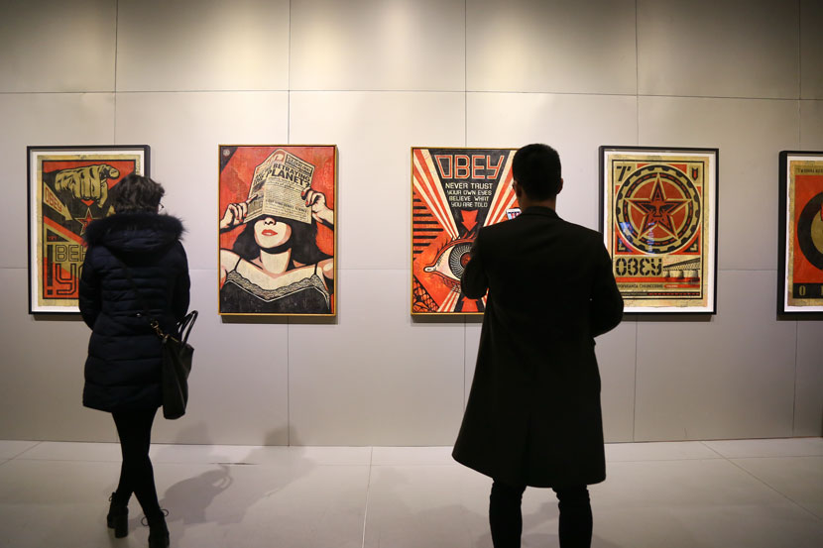
Unit 4/F video urban art

Slide 3
Before you watch 1 Work in groups. Look at the photo and discuss the questions.
1 Where are the people?
2 What is unusual about the exhibition?
3 What do you know about graffiti?
Aside from graffiti, what other kinds of urban art can you think of? What kinds of art do you think you are going to see in this video?

Slide 4
Click on the link to watch the video
https://www.youtube.com/watch?v=LMHXChEUuLw

Slide 5
While you watch
Watch the video and check your answers from Exercise 2. 4 Watch the video again and put these things in the order you first see them.
a a painting of a Japanese woman
b a train
c an art gallery
d a CD cover
e a shopping cart
f paint cans
g a trumpet

Slide 6
Mark whether each statement is true about Nick Posada (P) or Jafar Barron (B).
a He is a trumpeter.
b He is a graffiti artist.
c He grew up in a Philadelphia neighborhood.
d He has a record deal.
e He grew up in Washington, DC.
f His parents are jazz musicians.
g His first exhibition was in Georgetown.
h He plays in clubs where he grew up

Slide 7
Answer the questions.
1 In what ways is urban art about innovation? Give three examples.
2 Why is Nick Posada disappointed when he visits the wall of fame?
3 What does Nick think real graffiti artists know?
4 Why does Chris Murray like graffiti art?
5 What is Jafar Barron’s music a mix of?
6 What does Jafar think are his influences?

Slide 8
7 Use these words and phrases to complete what Don Kimes says about urban art (03:20 to 03:36).
{authentic, boundaries, come from, emerge, envelope, one more step, to the edge}
It’s about sort of taking what it is that you ________ what you ________from, what’s ________ for you and pushing it ____________ of its____________ , to the edge of its ____________ , its limits and taking _________________- .

Slide 9
Role-play
interviewing an urban artist Work in pairs.
Student A: Imagine you are an urban artist.
Choose a medium (visual or sound).
Invent information about the following:
● your life (for example, where you grew up, what your parents do, where you live now)
● your art (for example, what you do, why you do it, what your inspiration is)
● your aspirations (for example, what you would like to happen, where you see your work in five years’ time)

Slide 10
Student B: Imagine you are a local reporter. Interview the urban artist about his or her life, art, and aspirations.
Act out the interview, then change roles and act out the conversation again.
Student B should choose a different medium.

Slide 11
Work in groups and discuss these questions.
1 What type of art do you like?
2 Does the type of art you like differ from art in your parents’ generation? How?
3 Is innovation in art a good thing?

